Slide 1


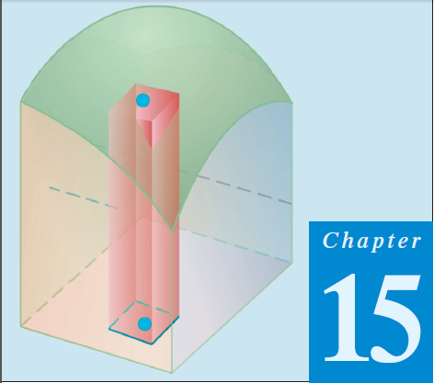
Thomas Calculus 11th
12
Triple Integral In Cylindrical Regions
Samuel Lukas

Slide 2
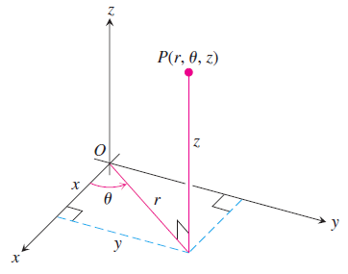


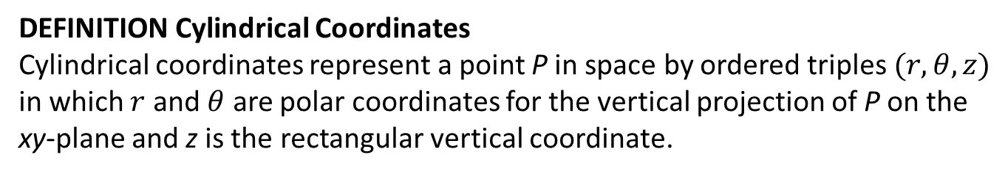



Cylindrical and Spherical Coordinates
DEFINITION Cylindrical Coordinates
Cylindrical coordinates represent a point P in space by ordered triples $(r,θ,z)$ in which $r$ and $θ$ are polar coordinates for the vertical projection of P on the xy-plane and z is the rectangular vertical coordinate.
$$x=r\cos\left(θ\right)$$
$$y=r\sin\left(θ\right)$$
$$z=z$$
$$x^{2}+y^{2}=r^{2}$$

Slide 3
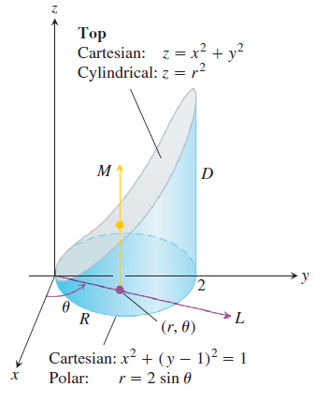



Slide 4

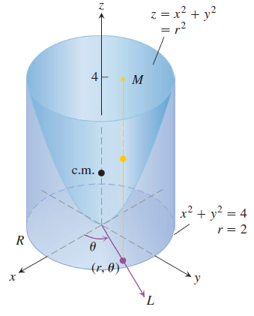





Examples 1

Slide 5
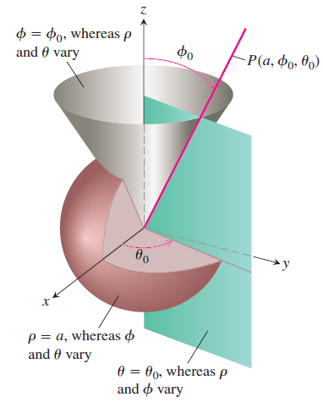
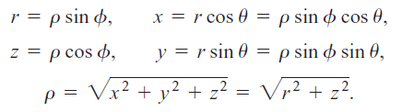



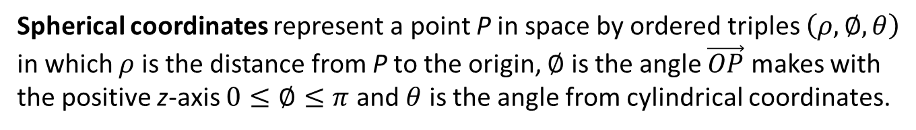
Spherical Coordinates and Integration
Spherical coordinates represent a point P in space by ordered triples $\left(ρ,∅,θ\right)$ in which $ρ$ is the distance from P to the origin, $∅$ is the angle $\vec{OP}$ makes with the positive z-axis $0≤∅≤π$ and $θ$ is the angle from cylindrical coordinates.

Slide 6
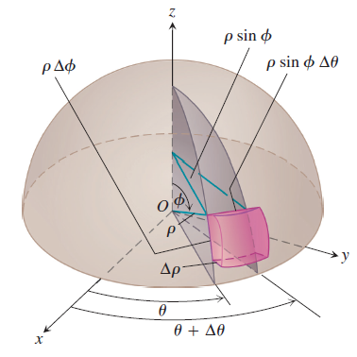



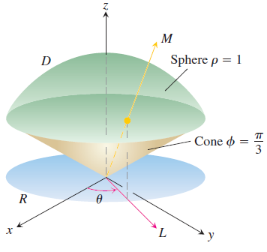



Slide 7




Slide 8







Exercises 1
Evaluate the cylindrical coordinate integrals in Exercises 1 – 4.
01.
02.
03.
04.
05.
06.
07.

Slide 9
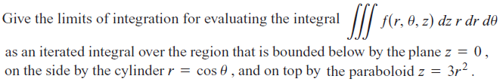

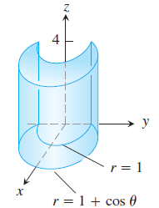

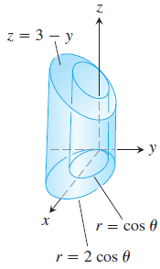
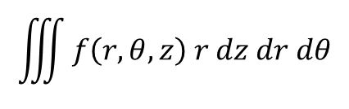
08.
09.
$$\iiint{f\left(r,θ,z\right) r dz dr dθ}$$
Set up the iterated integral for evaluating over the given region D.
10.
11.

Slide 10
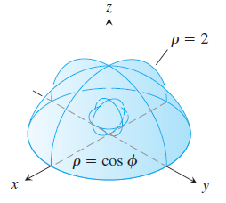
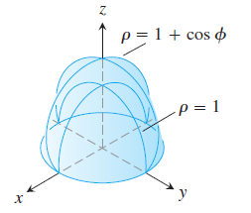
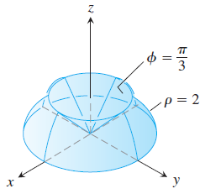
12.
13.
14.

Slide 11
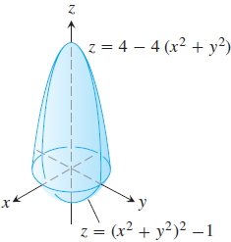
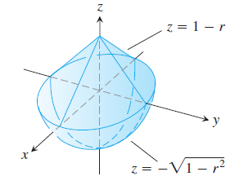
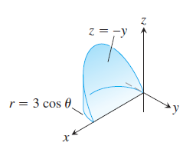
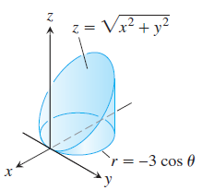
Find the volumes of the solids in Exercises 15 – 18.
15.
16.
17.
18.

